Slide 1

PROJECT PRESENTATION SOLAR RADIATION PREDICTION Using Machine learning
SUPERVISOR: DR. HAILIYA AHSAN(Assistant Professor) CO-SUPERVISOR: DR. SHOEB HUSSAIN(Assistant Professor) PRESENTED BY: DHRUV SHARMA (2020BELE024) ANURUDRA YADAV (2020BELE077) KAUSHINDER (2020BELE099)

Slide 2
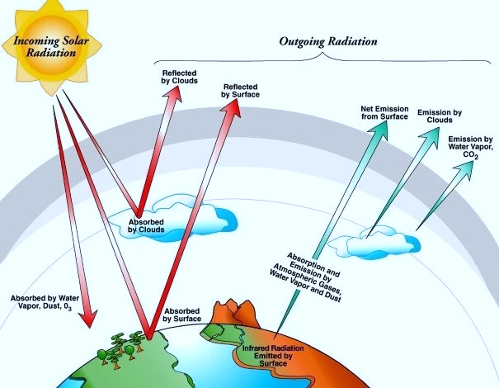
Solar Radiation
Solar radiation plays a crucial role in various aspects of our lives, from powering renewable energy systems to influencing agricultural productivity and climate patterns.
However, accurately predicting solar radiation levels is challenging due to the complex interplay of weather conditions, geographical factors, and atmospheric dynamics.
In this project, we aim to develop a model that can predict solar radiation levels with high accuracy.
We hope to contribute to the advancement of renewable energy technologies and enhance our understanding of earth's energy balance."

Slide 3
IMPORTANCE OF SOLAR RADIATION PREDICTION
1.
Grid operators to manage the integration of solar energy into the grid. Accurate predictions enable them to balance supply and demand, reduce the need for backup power sources, and prevent grid instability.
2.
It can help optimize the design of buildings for energy efficiency, as well as assist farmers in planning crop planting and harvesting times based on sunlight availability
3.
GRID MANAGEMENT
COST REDUCTION
URBAN PLANNING AND AGRICULTURE
Predicting solar radiation more accurately, energy producers can reduce costs associated with inefficient energy production and grid management.

Slide 4
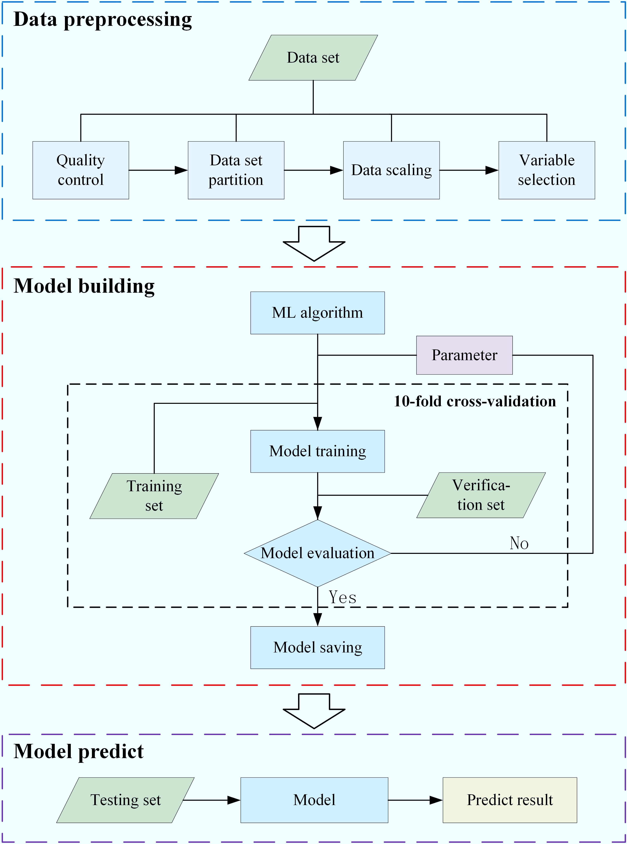
OUR APPROACH
● Solar radiation relies on weather patterns.
● The dataset has a total of 32,686 samples.
● 11 attributes are corresponding to each sample.
● Radiation is the response variable and the rest of the 10 attributes are the predictor variable.
● We plan to perform an 80-20 split to generate the train and test set.
Standard models:
1. Linear Regression 2. Decision Tree Regressor 3. Random Forest Regressor

Slide 5
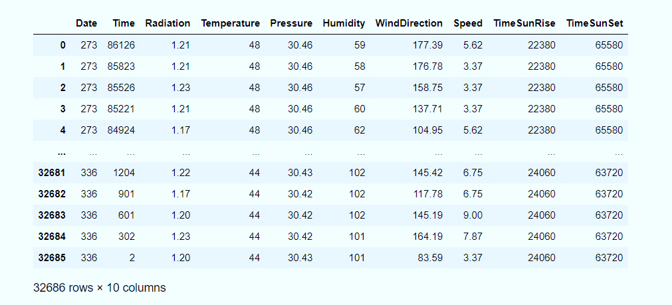
DATA PROCESSING
→Data preprocessing is crucial in data science to clean, transform, and prepare data for analysis. →It ensures data quality, improves model accuracy, and helps in extracting meaningful insights from the data. →A real world data generally contains noise, missing value and may be in unusable format. Fig: Solar Data Set after Pre Processing

Slide 6
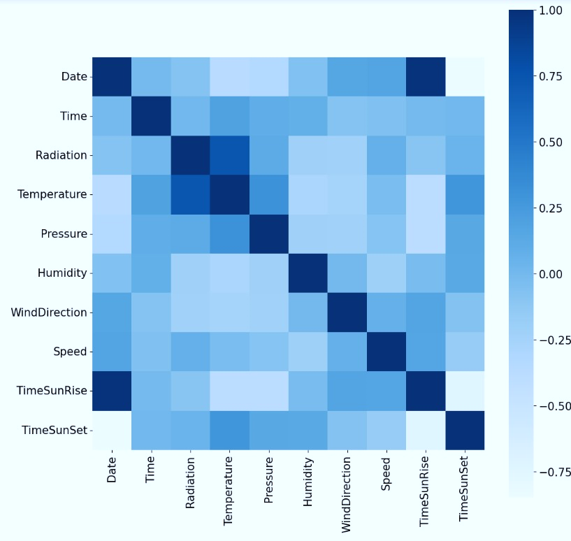
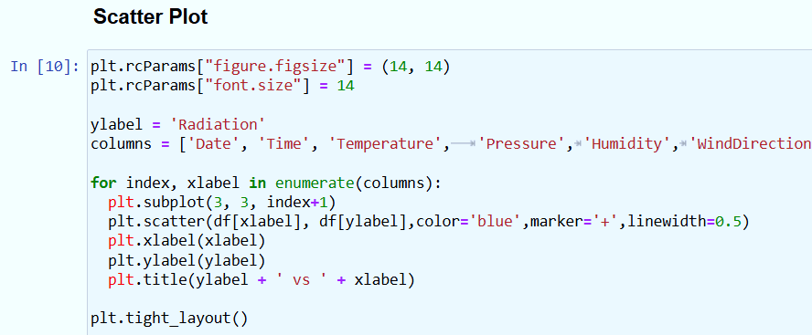
Feature selection
high correlation between temperature, pressure, humidity, and Wind Direction with radiation.
The sunrise and sunset dataset does not correlate with the radiation prediction so therefore we drop both these attributes

Slide 7
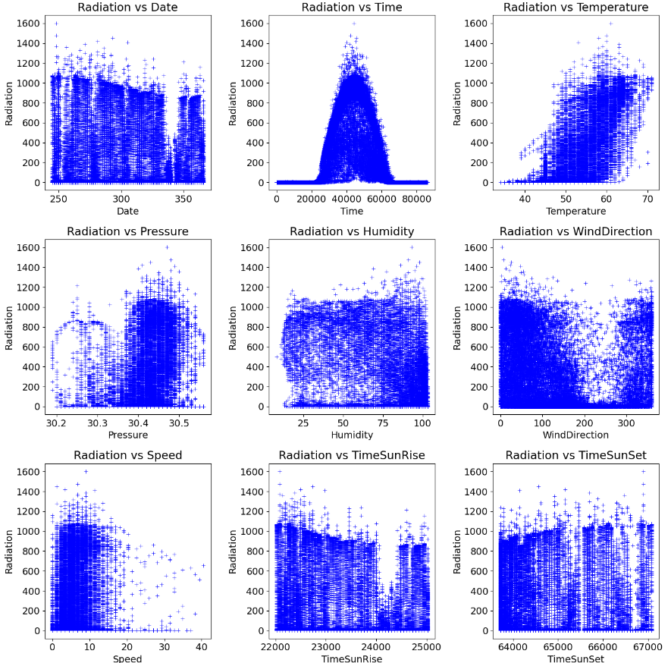
RADIATION VS ATTRIBUTES
High correlation between temperature, pressure, humidity, and Wind Direction with radiation.
The plot indicates that radiation depends on the time of the day.
Low →early morning,
Maximum → noon, and
Gradually decreases → end of the day.
Fig Scatterplot of different features of dataset against Radiation

Slide 8
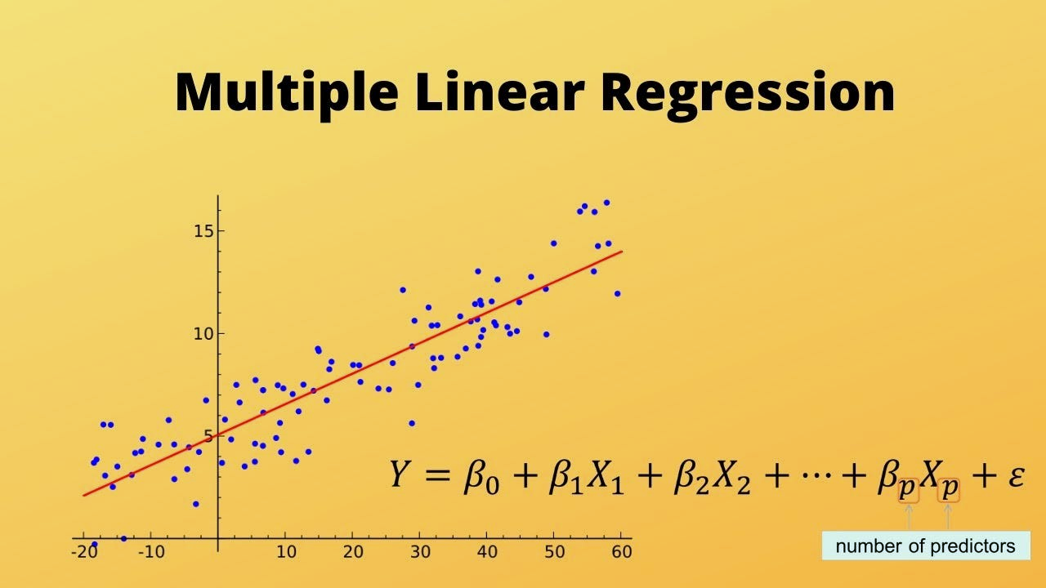
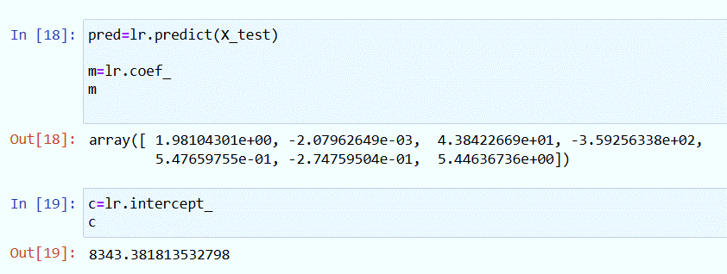
Multi LINEAR Regression Approach
Multiple linear regression is a statistical method used to model the relationship between multiple independent variables and a dependent variable.
Independent variable: Temp, speed. Pressure, humidity, wind direction etc.….
Dependent variable: Radiation

Slide 9
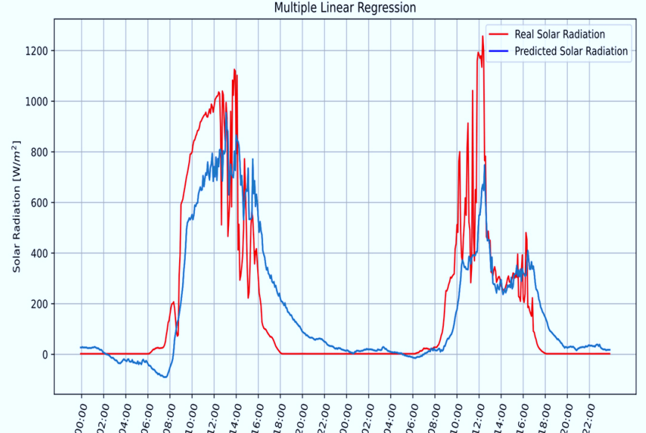
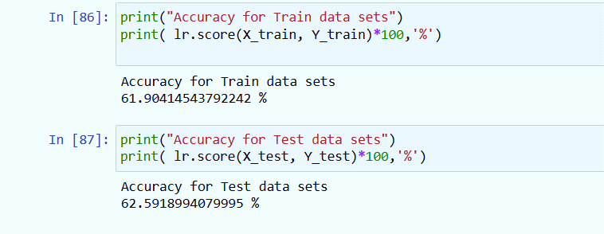
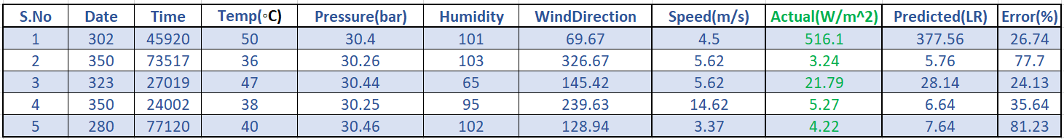
RESULT of Linear Regression
After performing different tests and using sensitivity analysis for this forecasting technique, it is deduced that the best parameters for tuning are those described in Table

Slide 10
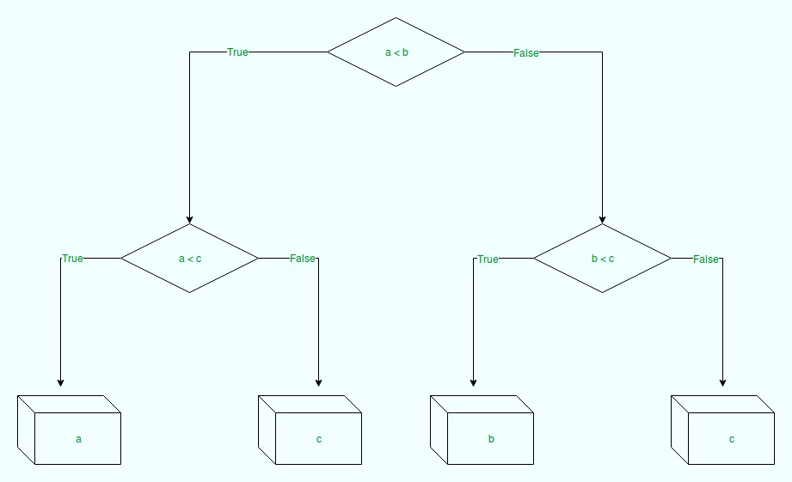
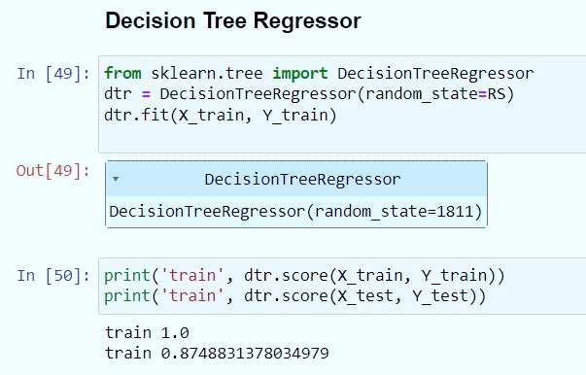
DECISION TREE REGRESSION
Decision tree regression observes the features of an object and trains a model in the structure of a tree to predict data in the future to produce meaningful continuous output.

Slide 11
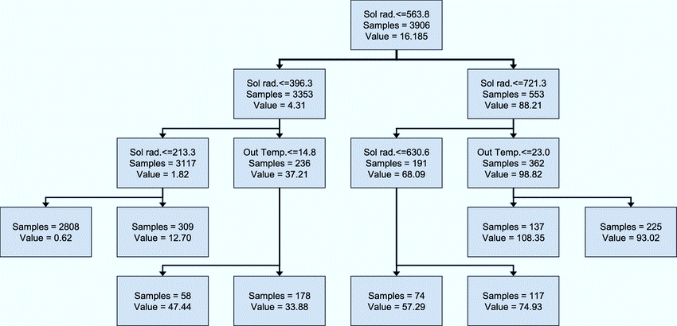
Decision tree Approach
Step-1: Begin the tree with the root node, says S, which contains the complete dataset.
Step-2: Find the best attribute in the dataset using Attribute Selection Measure (ASM).
Step-3: Divide the S into subsets that contains possible values for the best attributes.
Step-4: Recursively make new decision trees using the subsets of the dataset created in step 3. Continue this process until a stage is reached where you cannot further classify the nodes
the final node represent output.

Slide 12
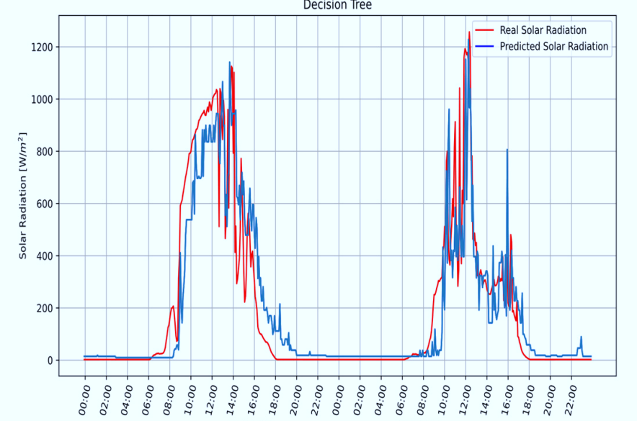
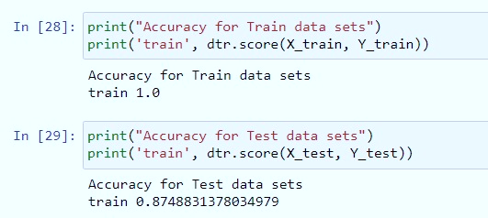
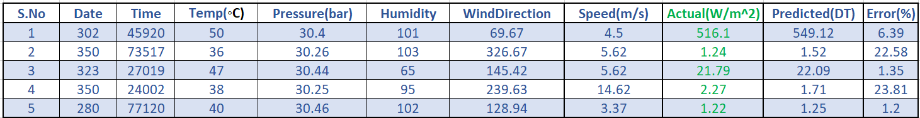
RESULT of Decision Tree
After performing different tests and using sensitivity analysis for this forecasting technique, it is deduced that the best parameters for tuning are those described in Table

Slide 13
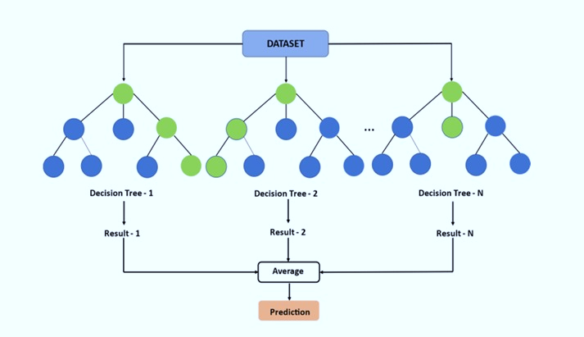
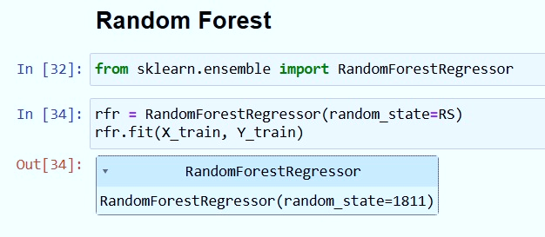
RANDOM FOREST REGRESSOR
Method that constructs multiple decision trees during training and combines their outputs for improved accuracy and robustness.
It is widely used for classification and regression tasks by averaging predictions or majority voting

Slide 14
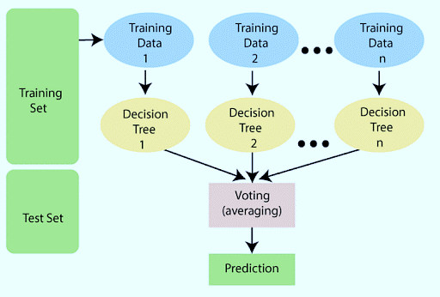
RANDOM Forest approach
Step 1: Select random samples from a given data or training dataset.
Step 2: This algorithm will construct a decision tree for every training data.
Step 3: Voting will take place by averaging the decision.
Step 4: Finally, select the average value as the final prediction result.

Slide 15
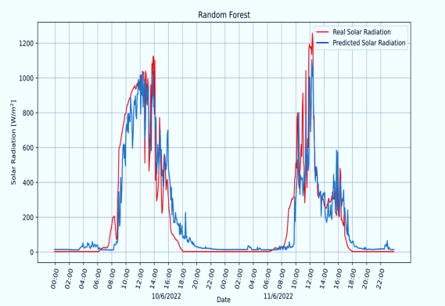
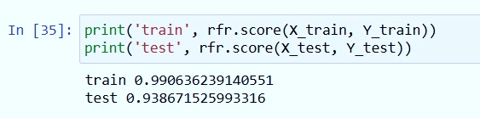
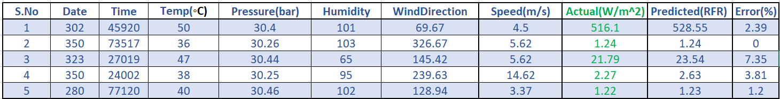
Random forest RESULT
After performing different tests and using sensitivity analysis for this forecasting technique, it is deduced that the best parameters for tuning are those described in Table

Slide 16
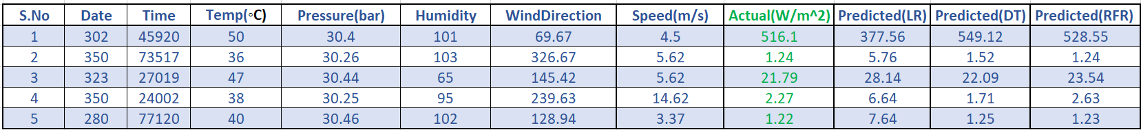
Results and COMPARISON
S.NO | MODEL-NAME | TRAIN DATASET ACCURACY | TEST DATASET ACCURACY
1 | Multiple Linear Regression | 61.90414 | 62.591899
2 | Decision Tree Regressor | 100 | 87.488313
3 | Random Forest Regressor | 99.0623 | 93.867152

Slide 17

FUTURE OF SOLAR RADIATION PREDICTION
Enhanced Data Collection: Continuously improve our data collection methods to incorporate new sources of data and enhance the quality and reliability of our predictions.
Model Refinement: Refine our machine learning algorithms to improve prediction accuracy, particularly in challenging weather conditions.
Global Scalability: Further refine our model to make it more scalable and adaptable to different regions and climates around the world.
Integration with Energy Systems: Explore ways to integrate our solar radiation prediction model with energy systems to optimize energy production and consumption.

Slide 18

FUTURE ASPECTS IN SOLAR ENERGY
• Advanced Photovoltaic (PV) Technologies
• Bifacial Solar Panels
• Solar Tracking Systems]
• Energy Storage Solutions
• Floating Solar Farms
• Digital solutions and Smart Grid Solutions
Green supply chain
Reduced carbon footprint
Waste reduction
Water conservation

Slide 19
CONCLUSION
A significant advancement in the field of renewable energy planning and grid management.
By machine learning algorithms and high-resolution satellite data, we have developed a model that can accurately forecast solar radiation levels, even in complex weather conditions.
These model has numerous practical applications, including optimizing energy production, improving grid stability, and advancing climate research.
Through our project, we have demonstrated the potential of data-driven approaches to enhance the reliability and efficiency of solar energy systems.
Future efforts will focus on enhancing data collection methods, refining machine learning algorithms, and integrating our model with energy systems to maximize its impact.

Slide 20
REFERENCES
Soomin, H.; Lumi, A.; Okorie, E.C.; Uredo, L.R. Investigation of Solar Energy: The Case Study in Malaysia, Indonesia, Colombia and Nigeria. Int. J. Renew. Energy Res. 2019, 9, 86–95.
Abdullah, W.S.W.; Osman, M.; Kadir, M.Z.A.A.; Varaiya, R. The potential and status of renewable energy development in Malaysia. Energies 2019, 12, 2437.2) https://www.kaggle.com/datasets/anikannal/solar-power-generation-data
Solar irradiance forecasting models using machine learning techniques and digital twin: A case study with comparison. https://www.sciencedirect.com/science/article/pii/S2666603023000064
https://www.researchgate.net/publication/343735894_Prediction_of_daily_global_solar_radiation_using_different_machine_learning_algorithms_Evaluation_and_comparison
https://www.kaggle.com/datasets/dronio/SolarEnergy

Slide 21
Thank you

